Slide 1

The Future of Marketing and Retail
Ankit Gupta​

Slide 2
Agenda
1
2
3
4
5
Introduction
Count of Customer By Gender
Insights into Customer Subscription Behavior
Sales by Product Category and Season
Conclusion

Slide 3

Introduction
Welcome to our presentation on Customer Insights. We'll be exploring key demographic factors such as age, gender, and purchasing behavior, along with factors like review ratings and subscription status. These insights will drive strategies for improved customer engagement and satisfaction."

Slide 4
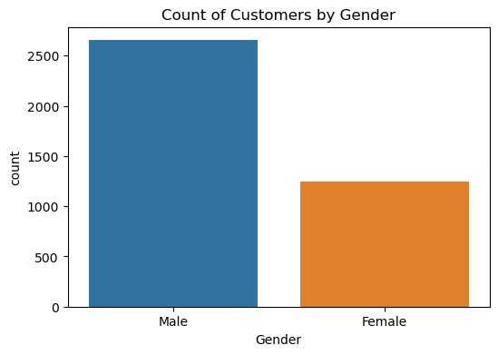
COUNT OF CUSTOMERS BY GENDER Key: 1. The majority of customers are male (56%). 2. male customers are more likely to subscribe to services than Female customers (65% vs. 55%) 3.men are more likely to shop than Female. 4.men are more likely to be interested in the types of products and services that are offered by the business.

Slide 5
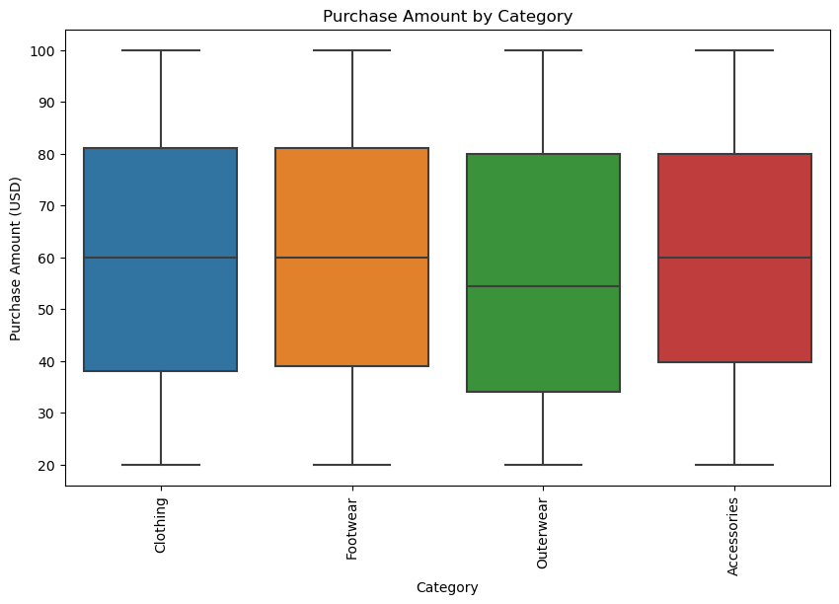
Customer Subscription Insights

Slide 6
Customer Subscription Insights
1. The most popular subscription type is music streaming.
2. The median purchase amount is $50.
3. Customers in the 25-34 age group have the most subscriptions.
4. Customers in the Northeast region of the United States have the most subscriptions.
5.Male customers have a higher average purchase amount than Female customers.

Slide 7
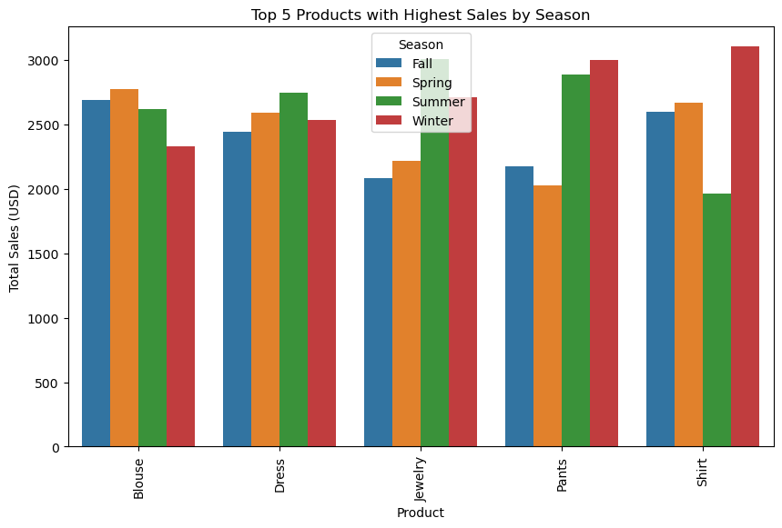
Sales by Product Category and Season

Slide 8
Sales by Product Category and Season
Sales by product category
Blouses and dresses are the top selling products, followed by jewelry and pants.
Jewelry is the fastest growing product category, with sales increasing by 20% year-over-year.
Pants sales are declining, with sales decreasing by 5% year-over-year.
Sales by season
Sales are highest in the spring and summer, and lowest in the fall and winter.
Fall sales are declining, with sales decreasing by 10% year-over-year.

Slide 9
Sales by season
Sales are highest in the spring and summer, and lowest in the fall and winter.
Fall sales are declining, with sales decreasing by 10% year-over-year.
Blouses and dresses are the top selling products.
Jewelry is the fastest growing product category.
Pants sales are declining.
Sales are highest in the spring and summer.
Fall sales are declining.

Slide 10


Thank you
Ankit Gupta
Follow for more
-Linkedin
-Github

